Slide 1
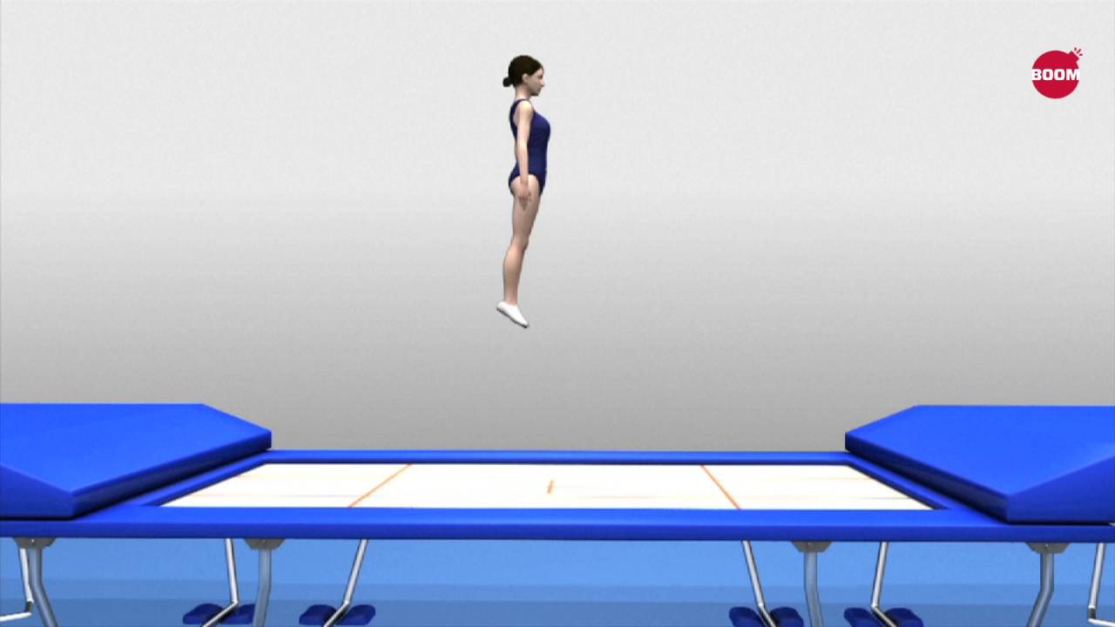
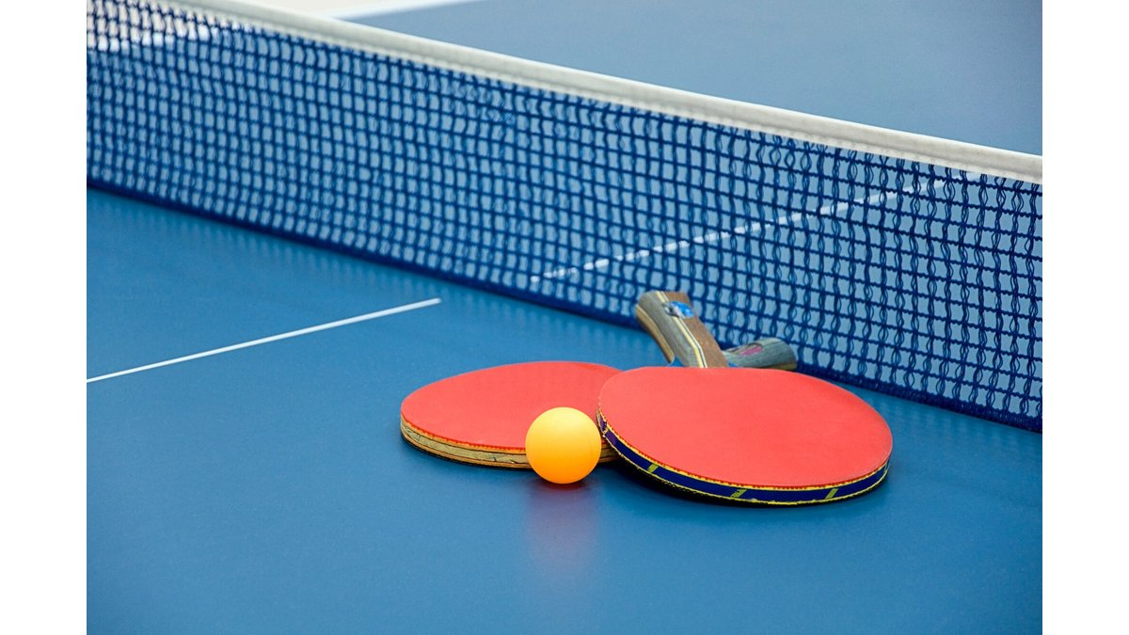
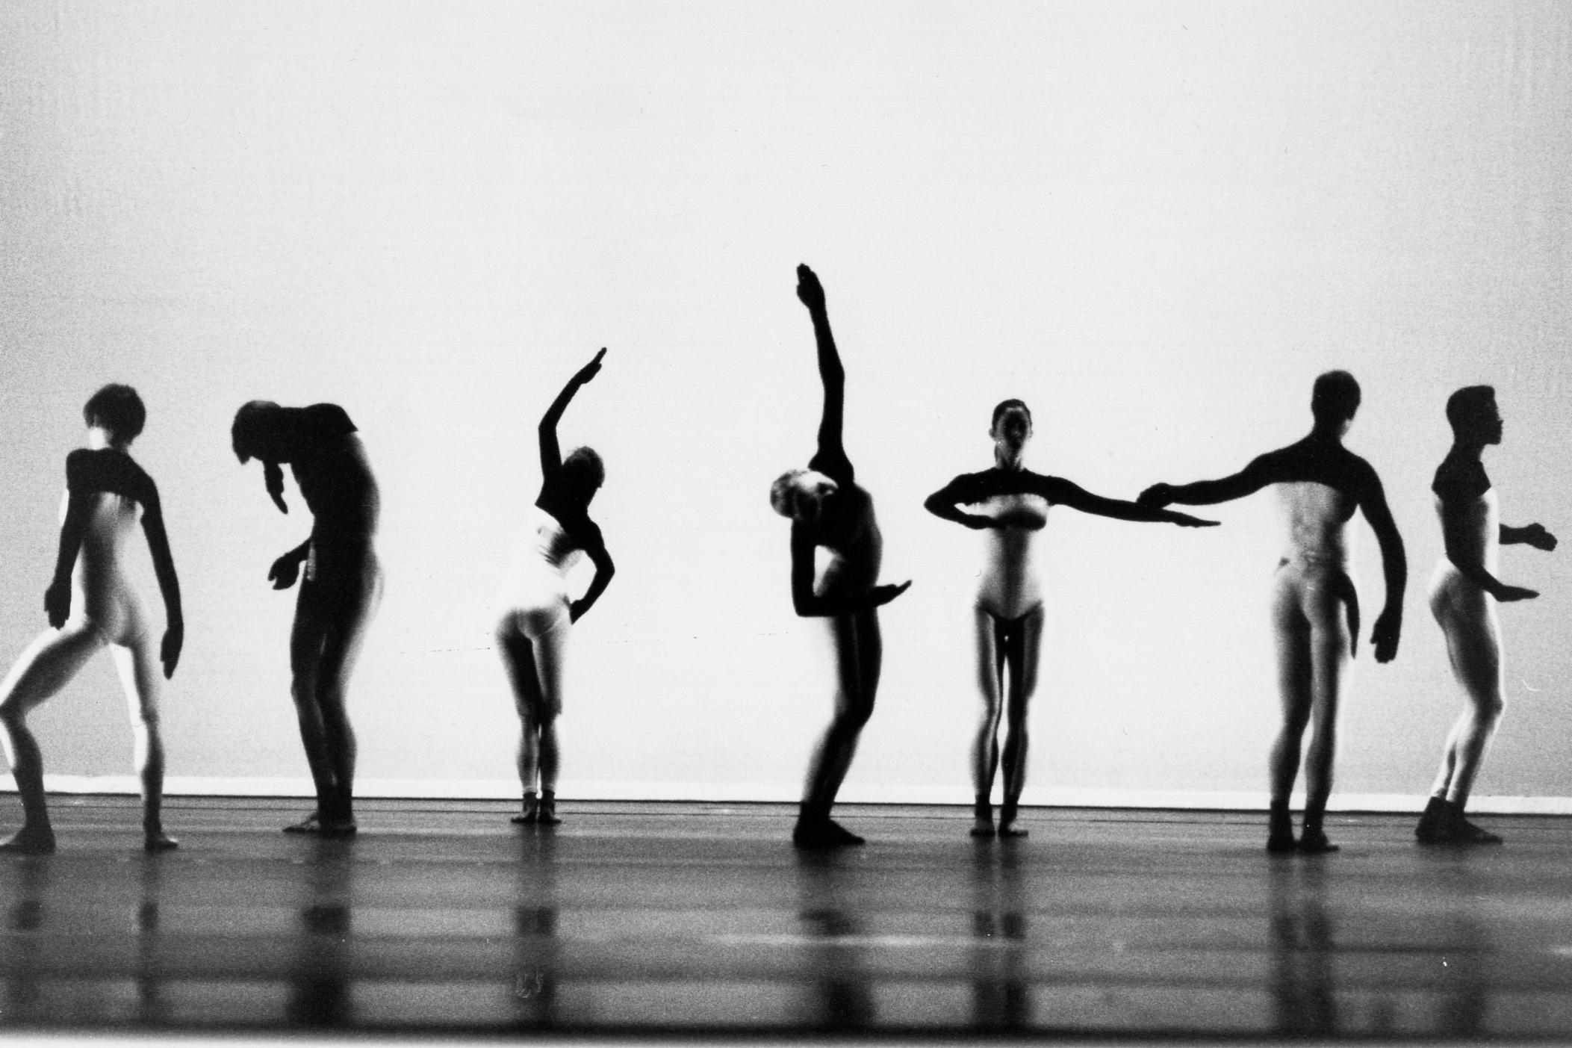
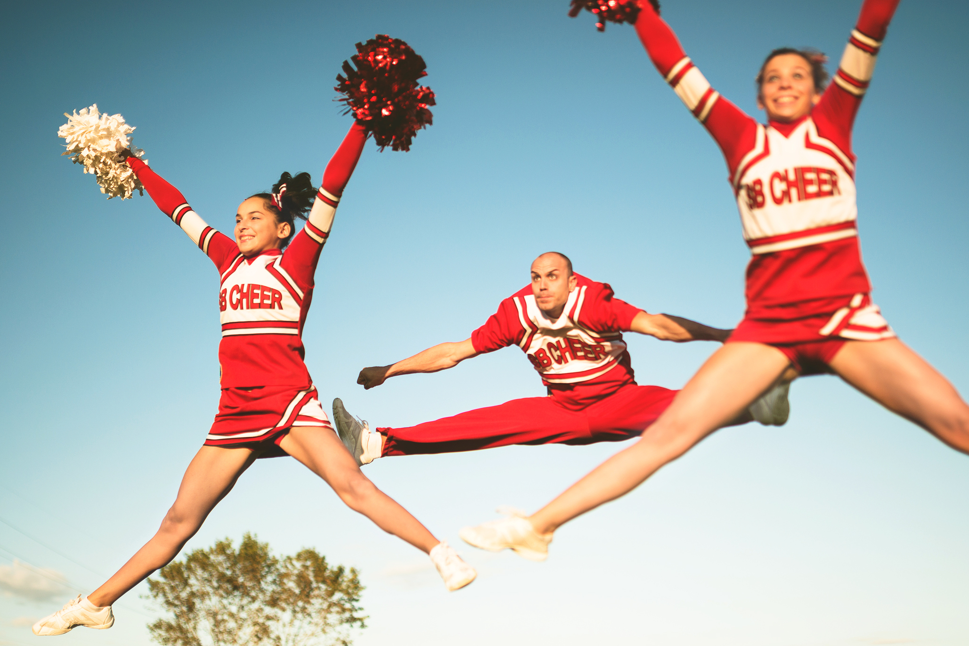
PE Extracurricular Spring 2
You do not need to sign up.
Please register and then get changed in the SH changing rooms. All clubs are from 3:15-4:15pm
Day | Activity | Location | Year Group | Staff Member
Monday | GCSE PE Catch Up | T8 | 11 | RBR
Tuesday | Dance | Hall | All Years | RBR
 | Table Tennis | Gym | All Years | MWI
Wednesday | Handball | Sports Hall | 7, 8 & 9 | DSM
 | Cheerleading | Gymnasium | 7 & 8 | AHO
Thursday | Trampolining | Sports Hall | All Years | RBR

Slide 2
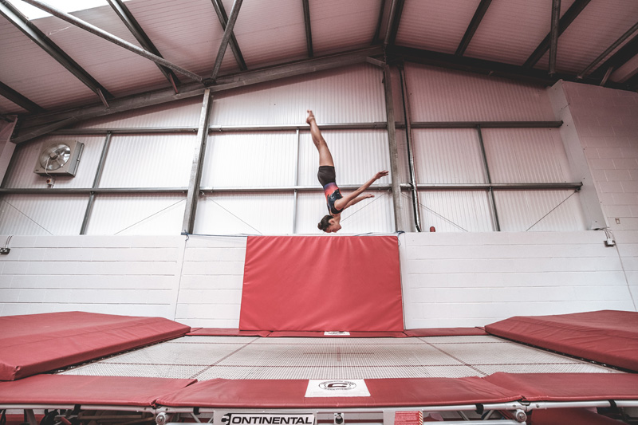
Teams Training Spring 2
You do not need to sign up or get changed.
Please just put your shorts and trainers on.
PE Lunchtimes Spring 2
Day | Activity | Year Group | Staff Member
Monday & Tuesday | Trampolining | KS4 | RBR & KHU
Wednesday, Thursday, Friday | Trampolining | KS3 | DSM, SED, MWI
Please register and then get changed in the SH changing rooms. All clubs are from 3:15-4:15pm
Day | Activity | Location | Year Group | Staff Member
Tuesday | Netball | Sports Hall | 7 & 8 | KHU
Wednesday | Football | 3G | 8 | TCL
 | Football | 3G | 9 | MWI
 | Football | 3G | 7 | PAS
Thursday | Girls Football | 3G | All Years | SED
 | Football | 3G | 10 | TSI
Friday | Netball | Sports Hall | 9 & 10 | RBR

